Slide 1



Session 2
CADM – Open source

Slide 2

MEET THE TRAINER
Zubair Saif
Senior Consultant – Systems Limited
CADM

Slide 3

Agenda
Data Binding in Angular
Interpolation in Angular
Property Binding in Angular
Event Binding in Angular
Two-way Binding & ngModel in Angular
Pipes in Angular
Component Communication

Slide 4

Data Binding in Angular

Slide 5
Data Binding in Angular
Data Binding
Data binding is a technique, where the data stays in sync between the component and the view. Whenever the user updates the data in the view, Angular updates the component.
The data binding in Angular can be broadly classified into two groups
One-way Binding
Two-way Binding

Slide 6
One-Way Data Binding
In one-way binding data flows from one direction. Either from view to component or from component to view.
From Component To View
To bind data from component to view, we make use of Interpolation and Property Binding.
Interpolation
Property Binding
From View To Component
Event Binding

Slide 7
Interpolation
Interpolation allows us to include expressions as part of any string literal, which we use in our HTML. The angular evaluates the expressions into a string and replaces it in the original string and updates the view.
Syntax: You use the {{ }} syntax to enclose expressions within your HTML template.
Usage: Interpolation is typically used to display dynamic content like strings, numbers, and variables from your component in the template.
Dynamic Updates: Whenever the value of a bound property in the component changes, the interpolated expression in the template updates automatically to reflect the new value.

Slide 8
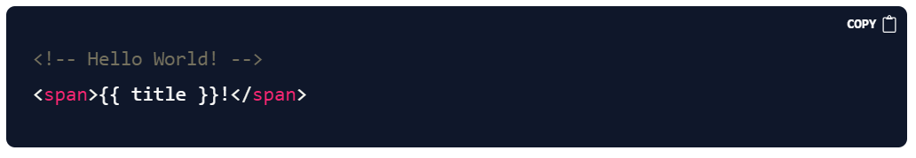
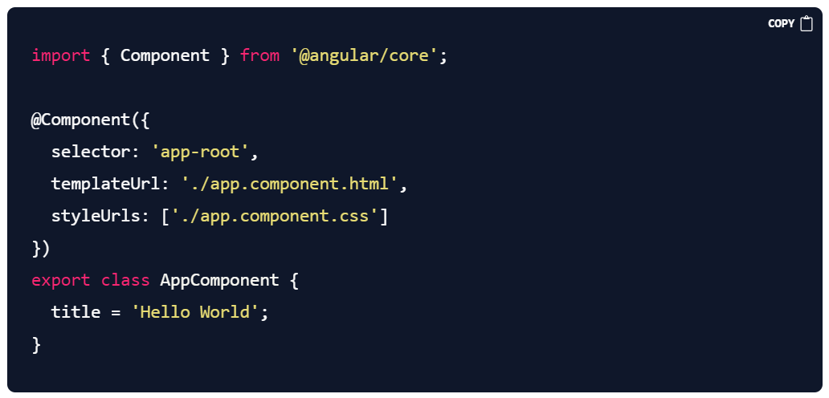
Example of Interpolation

Slide 9
Property Binding
It lets you set a property of an element in the view to property in the component.
Purpose: Property binding is a one-way data binding mechanism in Angular that allows you to dynamically set properties of HTML elements based on values from your component.
Syntax: To use property binding, you wrap the target property inside square brackets ([]) and bind it to a property of your component.
For example: [disabled]="isButtonDisabled".

Slide 10

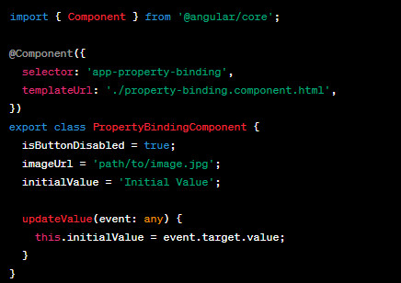
Example of Property Binding

Slide 11
Property Binding
The property binding has special syntaxes for setting the class & styles
Class Binding
Style Binding
Attribute Binding
Class Binding: Class binding is used to conditionally apply CSS classes to HTML elements. This is especially useful for changing the styling of elements dynamically.
Style Binding: Style binding allows you to dynamically set inline styles on HTML elements. This gives you fine-grained control over element styling.
Attribute Binding: Allows you to set HTML attributes conditionally or dynamically. This is useful when you need to modify attributes that aren't directly bound using property binding

Slide 12
Event Binding
From View To Component
Event Binding: Event binding allows us to bind events such as keystrokes, clicks, hover, touch, etc to a method in component.
For Example:-
when the user changes input in a text box, we can update the model in the component, run some validations, etc.
When the user submits the button, we can then save the model to the backend server.

Slide 13

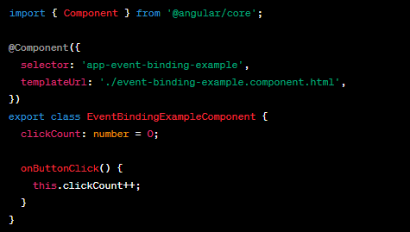
Example of Event Binding

Slide 14
Two Way Binding
Angular provides a mechanism called two-way binding to establish synchronization between a component's property and an input element's value.
It combines property binding and event binding to enable real-time updates in both directions.
Syntax:
Use the [(ngModel)] directive to achieve two-way binding.
It binds the value of an input element to a component property and updates the component property when the input's value changes.
Usage:
In the template, bind an input element using [(ngModel)]="propertyName".
The propertyName is a property in the component that will be synchronized with the input's value.

Slide 15

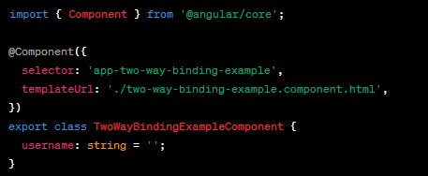
Example of Two-Way Binding

Slide 16
Pipes in Angular
Pipes
Pipes in Angular are used to transform and format data before displaying it in templates without changing the source value.
Pipes are applied within interpolation expressions {{ ... }} in templates.
Angular provides a set of built-in pipes for common transformations, and you can also create your own custom pipes
Built-in Pipes:
uppercase and lowercase: Convert text to uppercase or lowercase.
date: Format dates.
decimal: Format numbers with a fixed number of decimal places.
percent: Format numbers as percentages.
async: Handle asynchronous data.
json: Convert objects to JSON format.
slice: Extract a subset of an array or string.

Slide 17
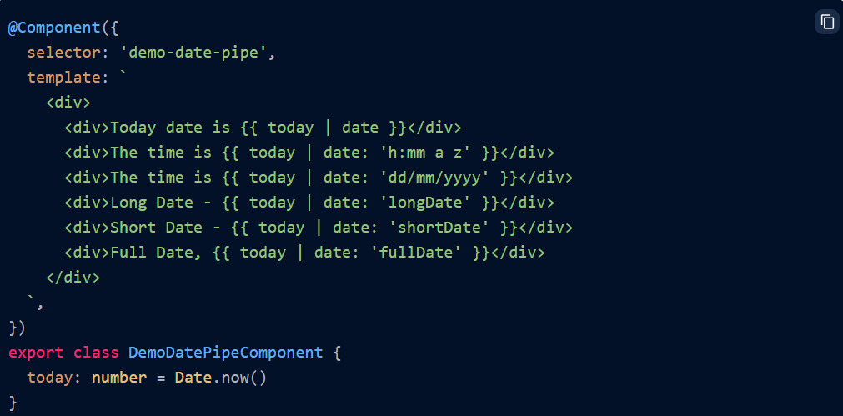
Date Pipe
To apply pipe, we must mention | (pipe) inside an expression before pipeName.
You can use the date pipe to format the Date object in various flavors.
Usage

Slide 18
Custom Pipes
The Angular comes with some great built-in pipes. But if these pipes do not cover your needs, then we can create our own pipe in Angular.
Creating Custom Pipes:
Use the @Pipe decorator to create a custom pipe.
Implement the PipeTransform interface to define the transformation logic.
The interface requires you to implement the transform method.
Usage:
Custom pipes can take parameters. Parameters can be passed within the parentheses after the pipe name: {{ data | customPipe:param1:param2 }}.
Chaining Pipes:
You can chain multiple pipes together to perform sequential transformations: {{ data | pipe1 | pipe2 }}.
Caution:
Custom pipes can have an impact on performance, especially when used in large lists. Use the pure property in the @Pipe decorator to control whether the pipe is re-evaluated on each change detection cycle.

Slide 19
Custom Pipes
How To Create Custom Pipes
To create a Custom Pipe, first, You need to follow these steps
Create a pipe class
Decorate the class with @pipe decorator.
Give a name to the pipe in the name meta data of the @pipe decorator. We will use this name in the template.
The pipe class must implement the PipeTransform interface. The interfaces contain only one method transform.
The first parameter to the transform method is the value to be transferred.
The transform method must transform the value and return the result.
Declare the pipe class in the Angular Module (app.module.ts)
Use the custom pipe just as you use other pipes.

Slide 20
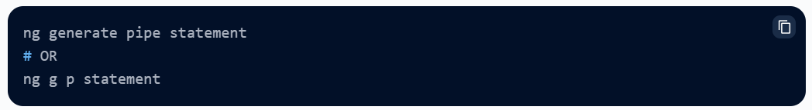
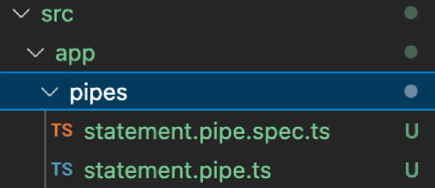
Custom Pipes
Custom Pipes
The custom pipe can be created by using CLI command.
It generates a folder name with pipes and adds statement.pipe.ts inside that folder.

Slide 21
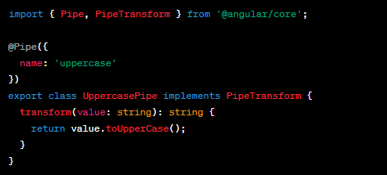

Example of Custom Pipes
You can chain multiple pipes together to perform sequential transformations: {{ data | pipe1 | pipe2 }}.

Slide 22
KeyValue Pipe
A built-in Angular pipe used to iterate over object properties and convert them into an array of key-value pairs.
Useful for displaying object properties in a list format or iterating over them using ngFor.
Usage:
Use the keyvalue pipe in the template like this: *ngFor="let item of myObject | keyvalue".
It transforms the object's properties into an array of key-value pairs.
Default Sorting
KeyValue pipe uses the key to sort the results array
Custom Sorting
You can customize it by providing a custom sort function (compareFn) as the first argument to the keyValue pipe

Slide 23
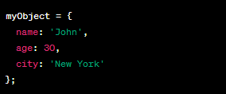

Example of KeyValue Pipes

Slide 24
Component Communication

Slide 25
Component communication
Component communication in Angular
Components often need to communicate and share data with each other.
Angular provides various methods for achieving this, including Input/Output properties and service.
Passing data from Parent to child component
Input: Input properties (`@Input()`): Allow data to flow from a parent component to a child component.
Passing Data from Child to Parent Component
Output: Output properties (`@Output()` and `EventEmitter`): Emit events from a child component to a parent component.
`@ViewChild` and `@ContentChild` decorators are used to access child elements or components within a parent component.

Slide 26
Pass data to child component

Slide 27
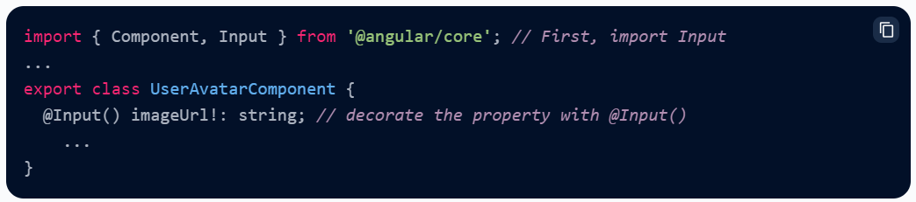
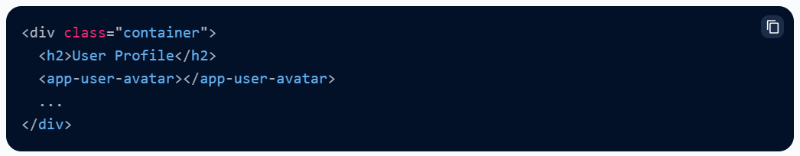
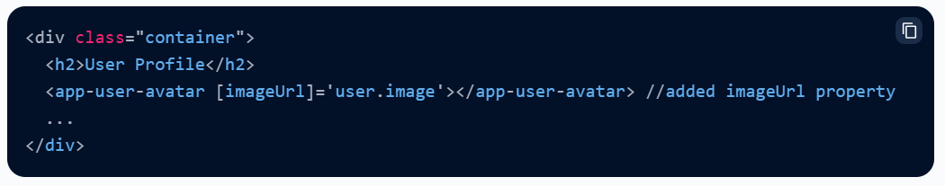
Input in Angular
How to Use @Input()?
In a child component or directive, use the @Input() decorator to inform Angular that a property in that component can get its value from its parent component.
In the Child
In the Parent

Slide 28
Pass data to parent component

Slide 29
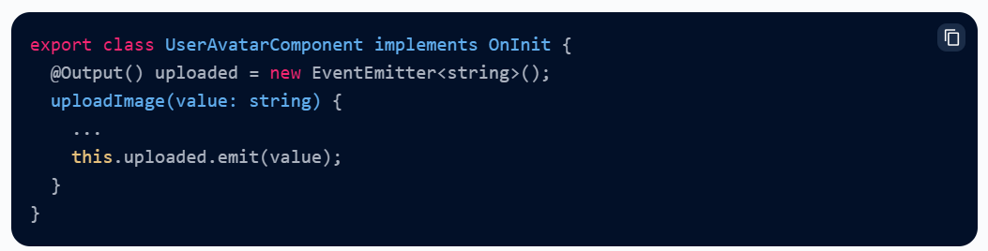
Output in Angular
How to Use @Output()?
In Angular, the @Output property decorator is used to create custom event emitters within components. This allows child components to emit events that parent components can listen for and respond
In the Child
First, make sure that the child component class imports Output and EventEmitter:
Next, still in the child, decorate a property with in the component class.
Data will be emitted via the .emit method and sent to the parent.

Slide 30
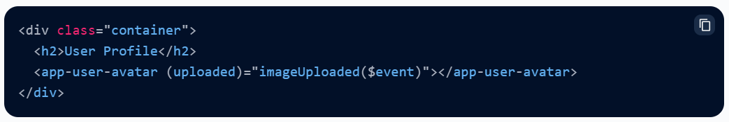

Output in Angular
In the Parent
Here, we will connect through html template. We will use (outputName) and connect it with any method in parent component.
@Input() and @Output() Together

Slide 31
@ViewChild()
Parent uses a @ViewChild() to get reference to the Child Component
Injecting an instance of the child component into the parent as a @ViewChild is the another technique used by the parent to access the property and method of the child component
The @ViewChild decorator takes the name of the component/directive as its input. It is then used to decorate a property. The Angular then injects the reference of the component to the Property

Slide 32
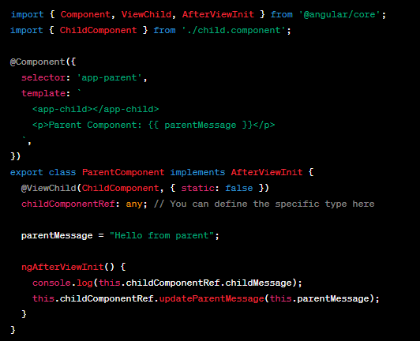
Example of @ViewChild
In this example, ParentComponent accesses the ChildComponent's message property using @ViewChild.
parent.component.ts:

Slide 33
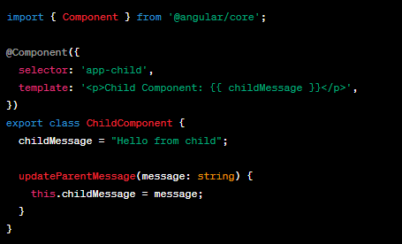
Example of @ViewChild
child.component.ts:

Slide 34

ANY QUESTION?

Slide 35



THANK YOU
Zubair Saif
mzubair.saif@systemsltd.com
CADM – OPEN SOURCE

